Slide 1
Image Processing using Matlab

Slide 2
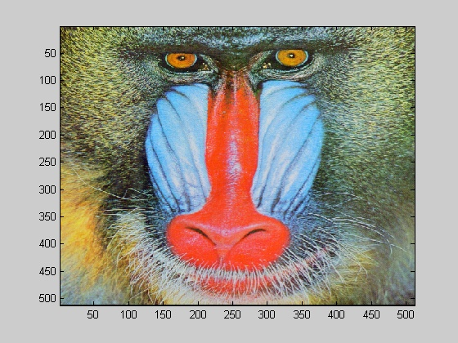

Loading and displaying images
>> I=imread('mandrill.bmp','bmp'); % load image
>> image(I) % display image
>> whos I
Name Size Bytes Class
I 512x512x3 786432 uint8 array
Grand total is 786432 elements using 786432 bytes
image format as a string
Matrix with image data
image filename as a string
Matlab can only perform arithmetic operations on data with class double!
Display the left half of the mandrill image
Dimensions of I (red, green and blue intensity information)

Slide 3
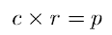
Greyscale images
>> w=imread('wombats.tif');
Now we can display this matrix as a greyscale image:
>> figure,imshow(w),pixval on
figure, which creates a gure on the screen. A gure is a window in which a graphics object can
be placed. Objects may include images, or various types of graphs.
imshow(g), which displays the matrix g as an image.
pixval on, which turns on the pixel values in our gure. This is a display of the grey values of the
pixels in the image. They appear at the bottom of the gure in the form

Slide 4
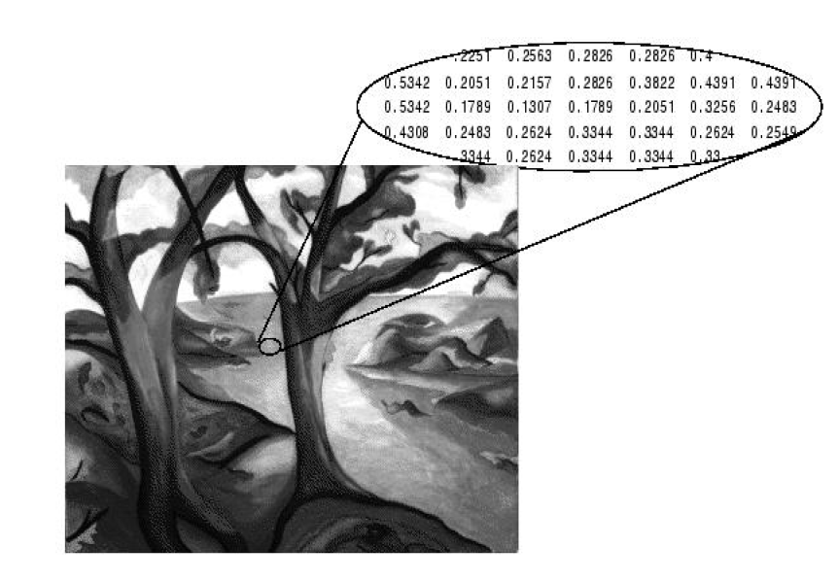

Slide 5
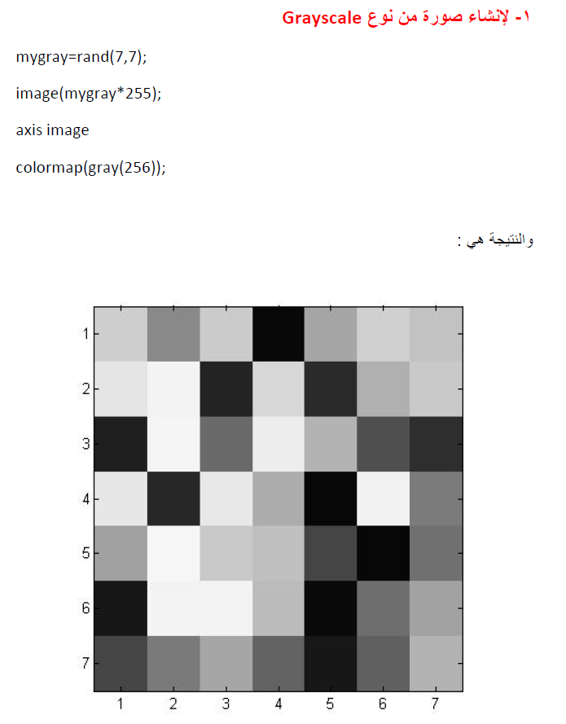

Slide 6
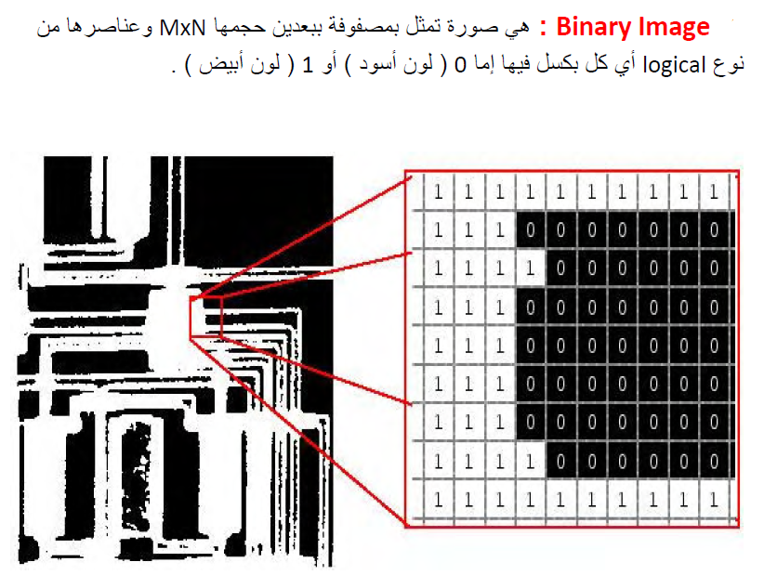

Slide 7
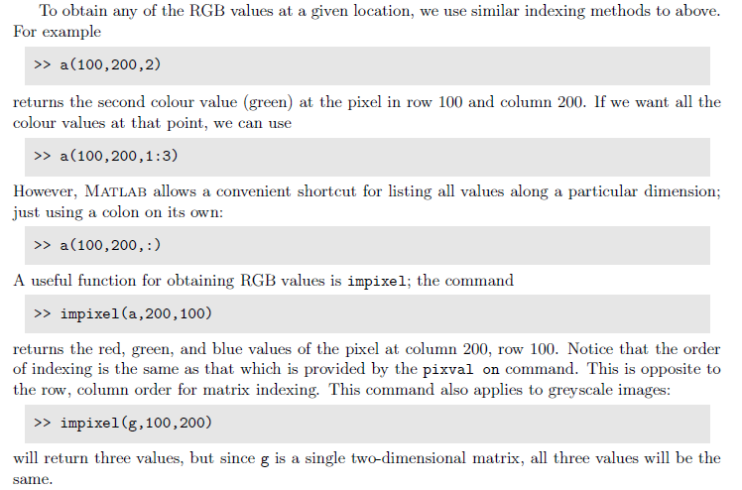
RGB Images
>> a=imread('autumn.tif');
>> figure,imshow(a),pixval on
An important dierence between this type of image and a greyscale image can be seen by the command
تعرض اللون الثاني وهو الاخضر (السطر ال100 والعمود 200)
>> size(a)
لعرض كل المصفوفات الثلاثة الالوان للسطر 100 والعمود 200
لعرض كل المصفوفات الثلاثة
للحصول على القيم للالوان الاساسية بالنسبة للسطر والعمود المحدد

Slide 8
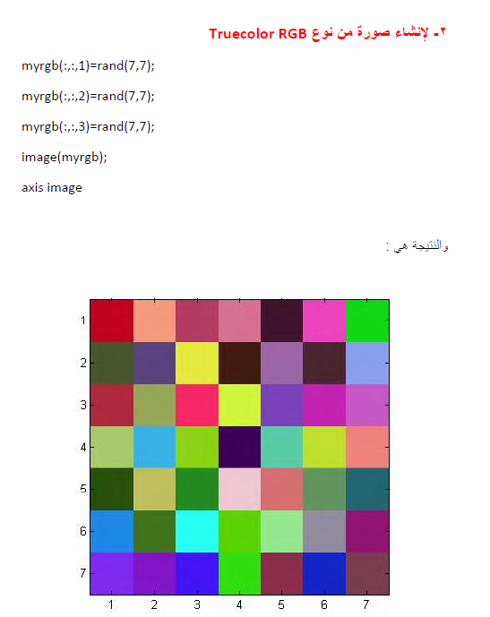

Slide 9
Indexed colour images
The command
>> figure,imshow('emu.tif'),pixval on
In fact the image emu.tif is an example of an indexed image, consisting of two matrices: a
colour map, and an index to the colour map. Assigning
>> [em,emap]=imread('emu.tif');
>> figure,imshow(em,emap),pixval on
Matlab stores the RGB values of an indexed image as values of type double, with values between 0 and 1.

Slide 10
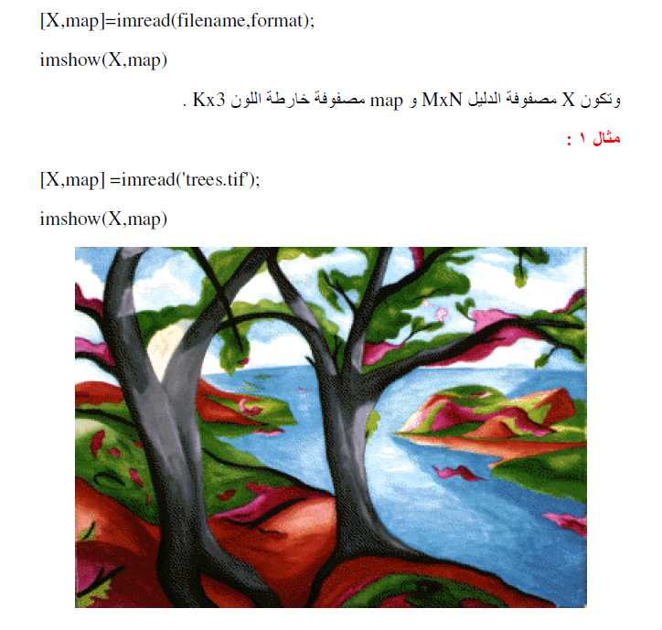

Slide 11
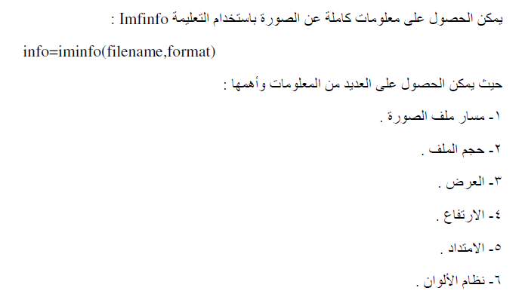

Slide 12
Information about your image
>> imfinfo('emu.tif')
ans =
Filename: 'emu.tif'
FileModDate: '26-Nov-2002 14:23:01'
FileSize: 119804
Format: 'tif'
FormatVersion: []
Width: 331
Height: 384
BitDepth: 8
ColorType: 'indexed'
FormatSignature: [73 73 42 0]
ByteOrder: 'little-endian'
NewSubfileType: 0
BitsPerSample: 8
Compression: 'PackBits'
PhotometricInterpretation: 'RGB Palette'
StripOffsets: [16x1 double]
SamplesPerPixel: 1
RowsPerStrip: 24
StripByteCounts: [16x1 double]
XResolution: 72
YResolution: 72
ResolutionUnit: 'Inch'
Colormap: [256x3 double]
PlanarConfiguration: 'Chunky'
TileWidth: []
TileLength: []
TileOffsets: []
TileByteCounts: []
Orientation: 1
FillOrder: 1
GrayResponseUnit: 0.0100
MaxSampleValue: 255
MinSampleValue: 0
Thresholding: 1

Slide 13
Uint8 image

Slide 14
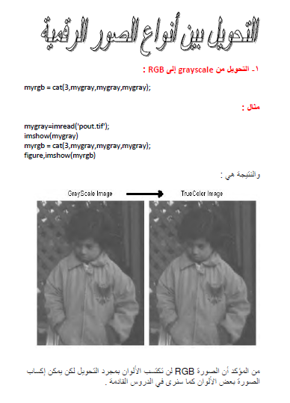

Slide 15
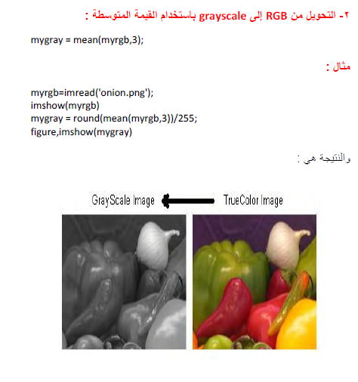

Slide 16
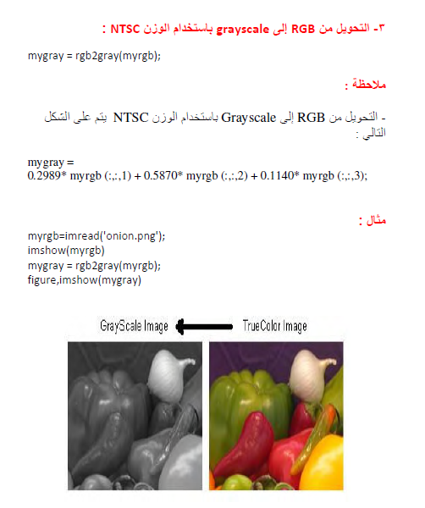

Slide 17
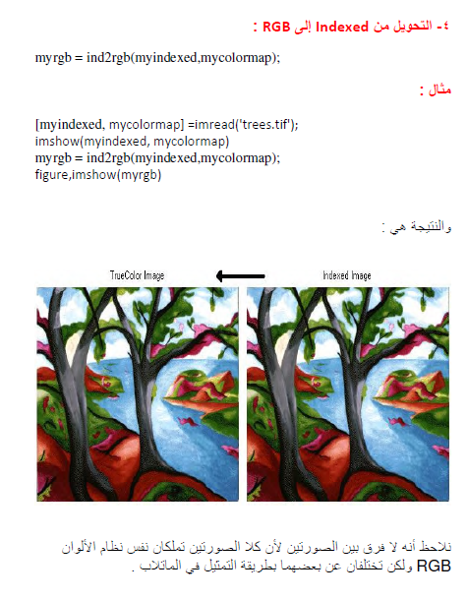

Slide 18
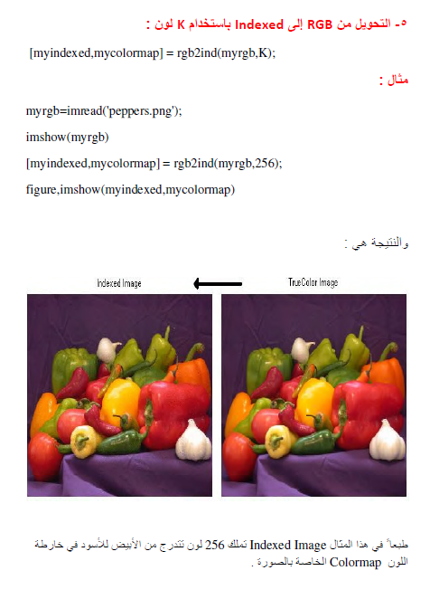

Slide 19
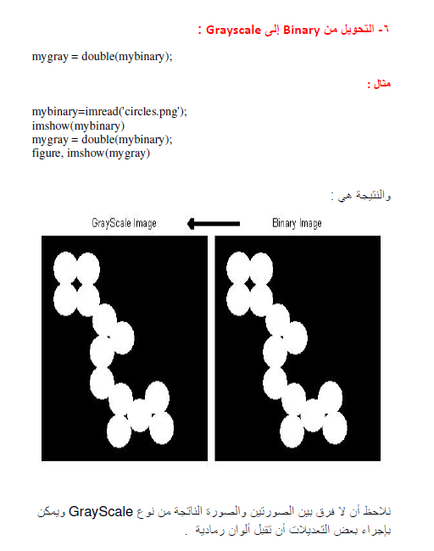

Slide 20
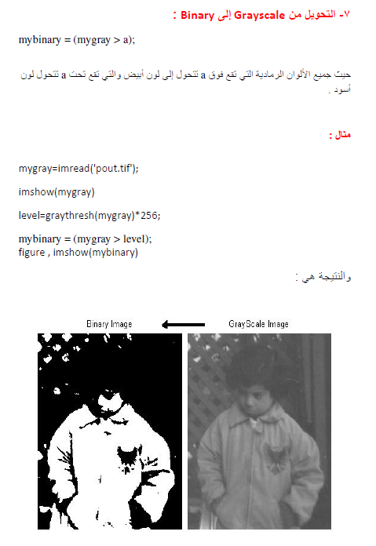

Slide 21
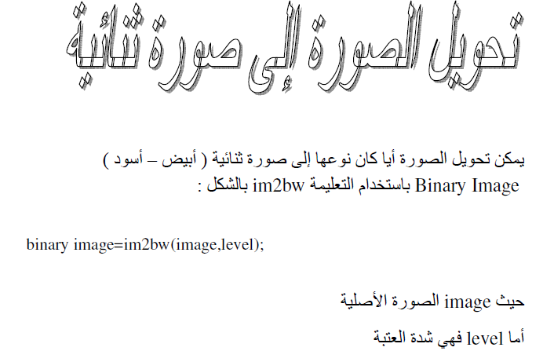
Data types and conversions

Slide 22
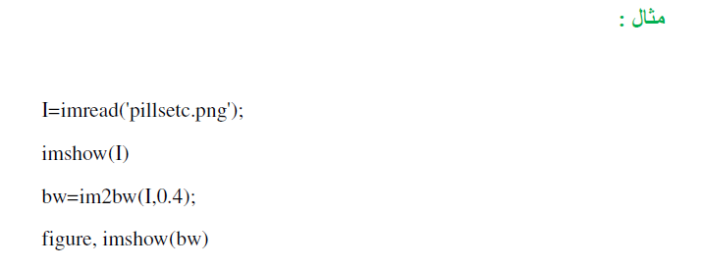

Slide 23
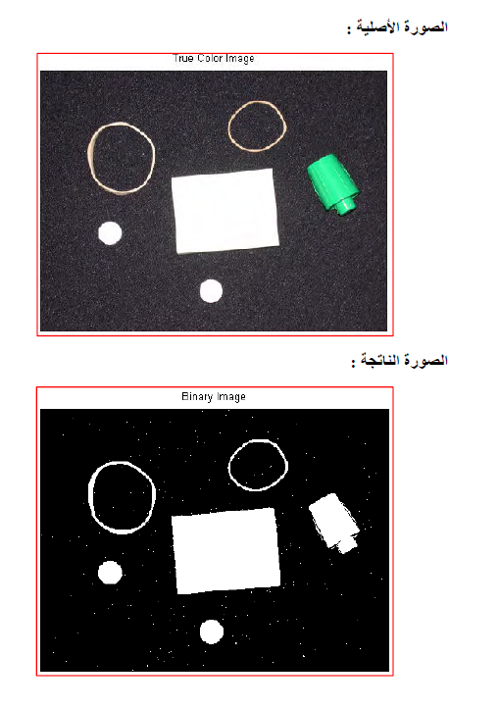
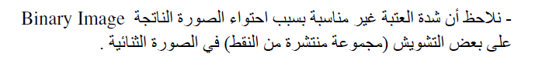

Slide 24
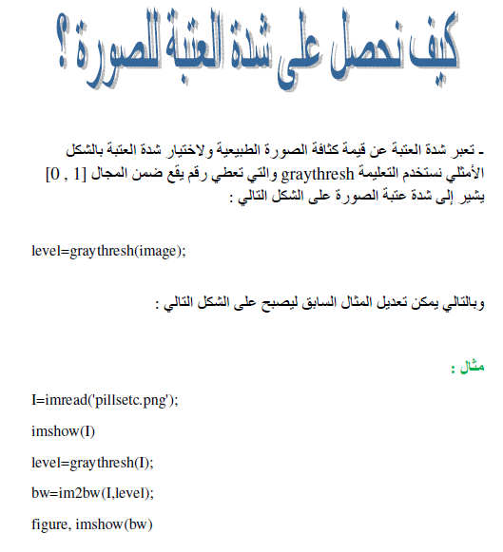

Slide 25
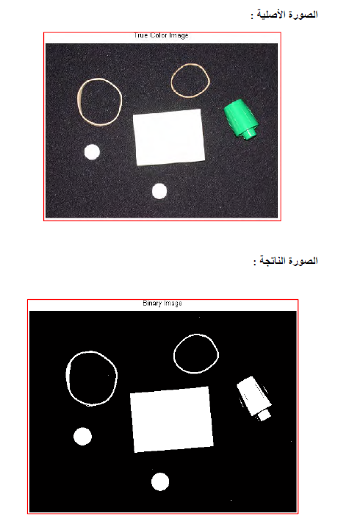

Slide 26
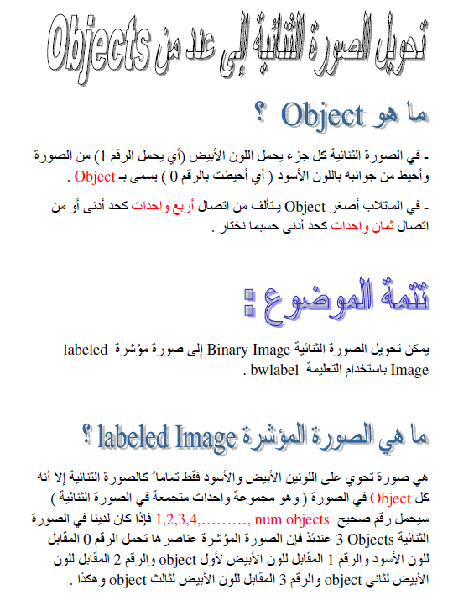

Slide 27
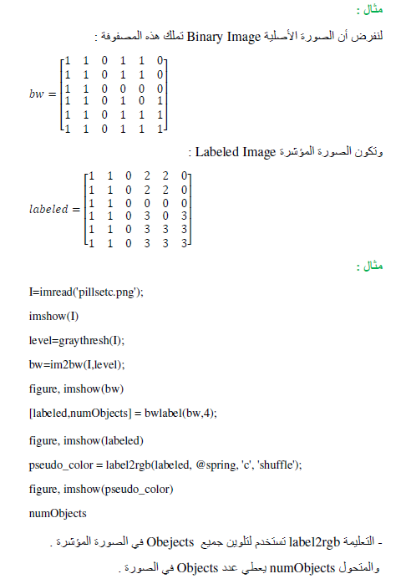

Slide 28
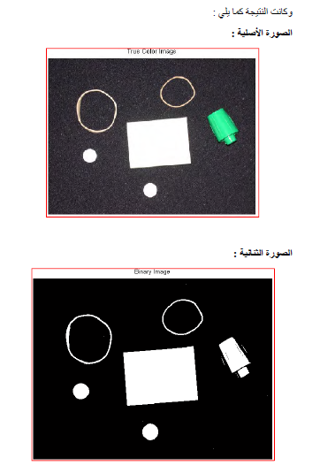

Slide 29
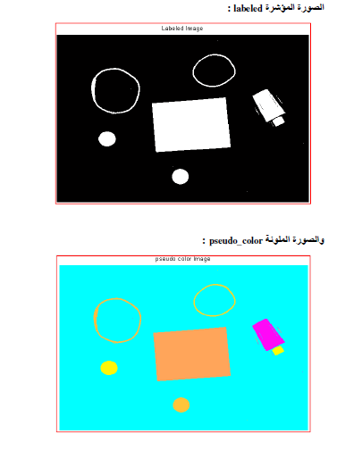

Slide 30
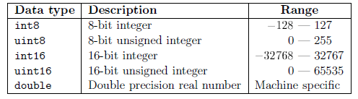
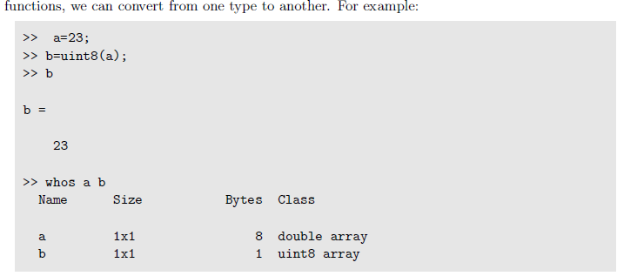
Data types and conversions

Slide 31
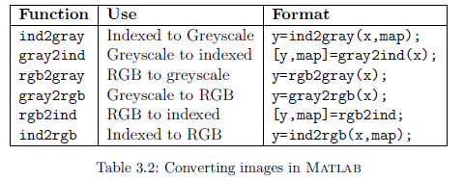
We can convert images from one image type to another. Table 3.2 lists all of Matlab's functions for converting between dierent image types.
1. convert to type uint8 and then display,
>> c=imread('caribou.tif');
>> cd=double(c);
>> imshow(c),figure,imshow(cd)

Slide 32
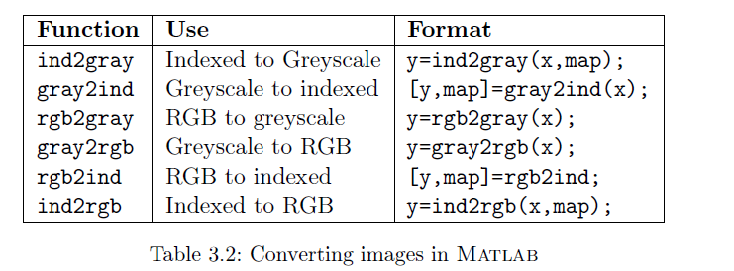

Slide 33
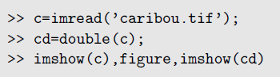
Image Display
we take an image and convert it to type double:
سنقوم بضرب الصورة في القيمة نفسها يعني اذا كانت لدينا فاننا سنضربها كل بكسل في القيمة
نفسها وعندها سنحصل على قيمة كبيرة لكل بكسل بمعنى سيكون اكبر من 1 وهذا سيجعلها بيضاء
واذا اردنا ان نحصل على الصورة الاصلية نقسمها على العدد 255 عندها سنحصل على الصورة الاصلية
Greyscale images
>> imshow(cd/255)

Slide 34
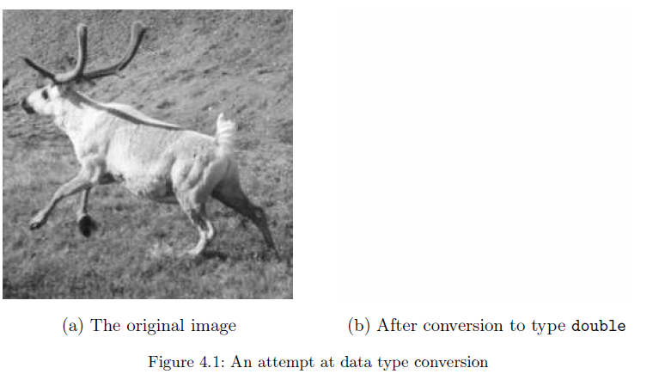
every pixel has value greater than or equal to 1 (in fact the minimum value is 21),
so that every pixel will be displayed as white.

Slide 35
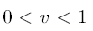
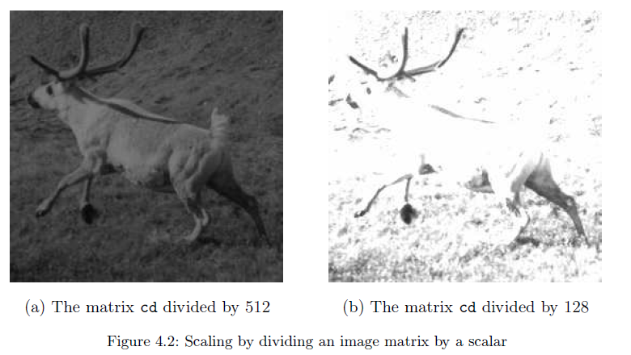
تعرض الصورة بيضاء اذا كانت قيمتها 1 وسوداء اذا كانت صفر
واذا كانت قمتها مابين 1 والصفر فانها تكون
grey scale
واذا كانت اكبر من 1 فانها ستعرض بشكل ابيض واذا كانت اقل من 0 ستعرض سوداء
>> imshow(cd/512)
>> imshow(cd/128)
عند قسمة 0-255 على 512 ستكون القيمة ما بين 0 و 0.5 ولذلك ستكون سوداء
اما اذا قسمنا 0-255 على 128 سيكون القيمة ما بين 0 و 2

Slide 36
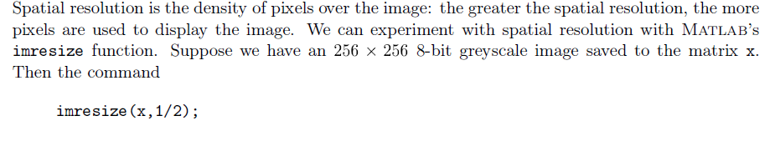
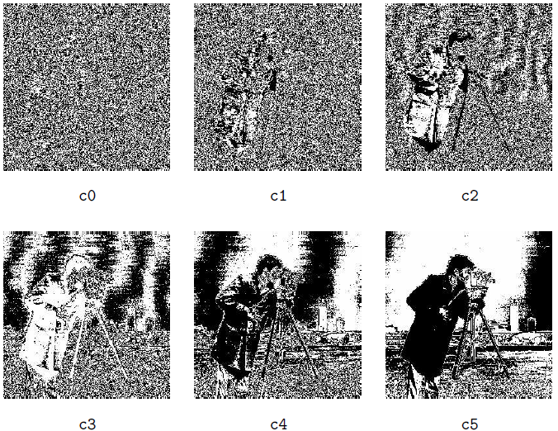
Spatial Resolution

Slide 37
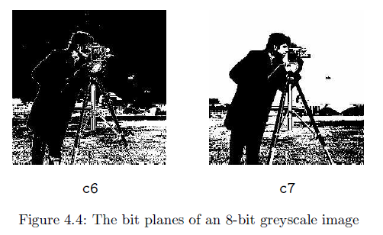
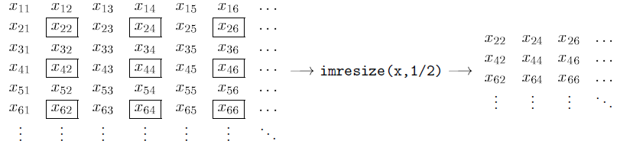

Slide 38
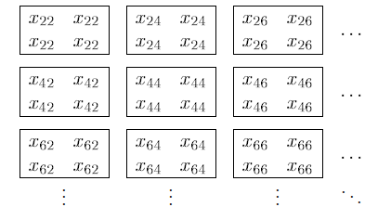
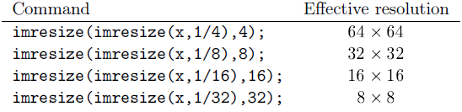
If we apply imresize to the result with the parameter 2 rather than 1/2, all the pixels are repeated to produce an image with the same size as the original, but with half the resolution in each direction:
The effective resolution of this new image is only 128x128 We can do all this in one line:

Slide 39
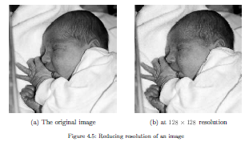
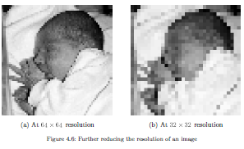
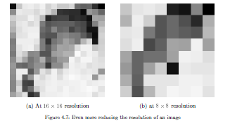
To see the effects of these commands, suppose we apply them to the image newborn.tif:

Slide 40
Point Processing:
Arithmetic operations
These operations act by applying a simple function y=f(x) to each gray value in the image.
Simple functions include adding or subtract a constant value to each pixel: y = x±C (imadd, imsubtract)
Multiplying each pixel by a constant: y = C·x (immultiply, imdivide)
Complement: For a grayscale image is its photographic negative.

Slide 41
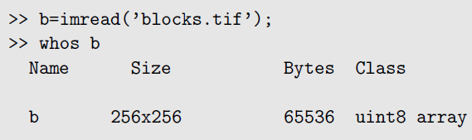
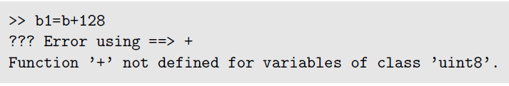
The point of the second command was to find the numeric data type of b; it is uint8. The unit8 data type is used for data storage only; we can't perform arithmetic operations. If we try, we just get an error message:

Slide 42
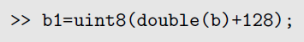
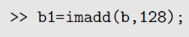
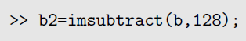
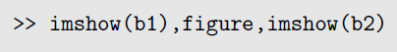
And now we can view them:

Slide 43
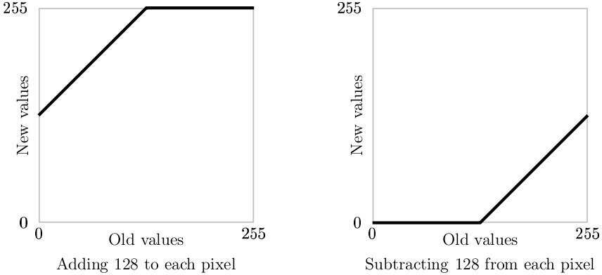
Arithmetic operations:
Addition, subtraction

Slide 44


Slide 45


Addition
Image: I
Image: I+50

Slide 46


Slide 47


Slide 48


Slide 49


Slide 50


Slide 51

Subtraction
Image: I
Image: I-80

Slide 52


Slide 53

Arithmetic operations:
Multiplication, division

Slide 54


Slide 55

Multiplication
Image: I
Image: I*3

Slide 56


Slide 57

Division
Image: I
Image: I/2

Slide 58


Slide 59

Complements
The complement of a greyscale image is its photographic negative. If an image matrix m is of type double
>> 1-m
If the image is binary, we can use
>> ~m
If the image is of type uint8, the best approach is the imcomplement function.
and the result of the commands
>> bc=imcomplement(b);
>> imshow(bc)

Slide 60

Complement

Slide 61


Slide 62

Complement
Image: I
Image: 255-I

Slide 63


Slide 65


Slide 66


Slide 67


Slide 68


Slide 69


Slide 70


